Slide 1
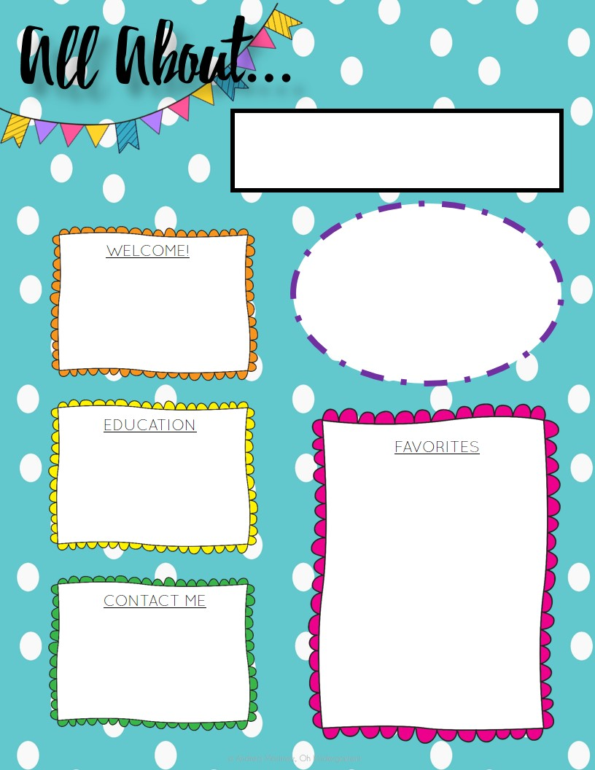
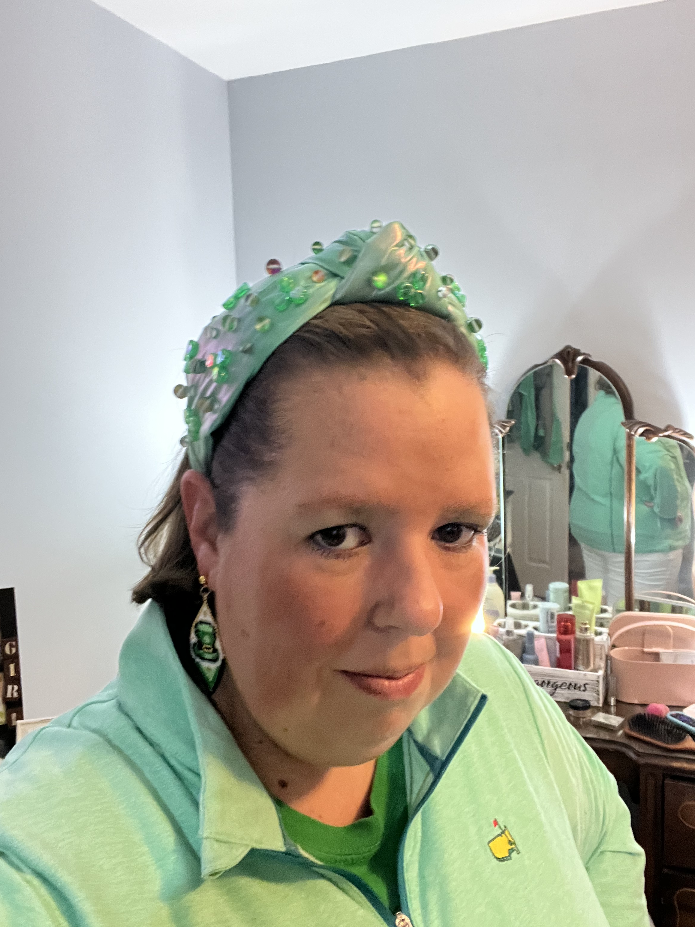
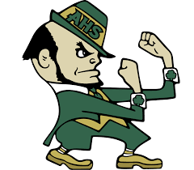
Miss Leonard
November 23
My name is Ginny Leonard (Miss Leonard). I was born in Augusta, GA and spent most of my life here in Augusta. This is my 10th year teaching. I have taught Pre-K and first grade.
Now I am excited about starting my 8th year teaching Kindergarten.
Favorite Sports to Watch
.
~ I have a bachelors degree in early childhood education from Georgia Southern with a minor in family child development
~ A Masters in Curriculum and Instruction from Thomas University.
Food
~ Mexican Food
~ Pizza (Any Italian Food Really)
~ Sea Food
~ Chips (Especially cheese flavor and jalapeno)
~ Sweet Tea
~ Dr. Pepper/ Mr. Pibb
~ Coke or Cherry Coke
Chill Time
~ Hanging with Family and Friends
~ Netflix and Chilling
~ Chilling at the pool, lake, or beach
Travel (Favorite Places)
Tybee Island/ Savanna GA ( Any beach)
Boston
New Orleans
Cruise (Wish List)
Ireland (Wish List)
Favorite Sports and Teams
Georgia Bull Dogs (College)
Aquinas Fighting Irish (Highschool)
Class Dojo
leonavi@boe.Richmond.k12.ga.us
Hains- 706-796-4918

